Slide 1
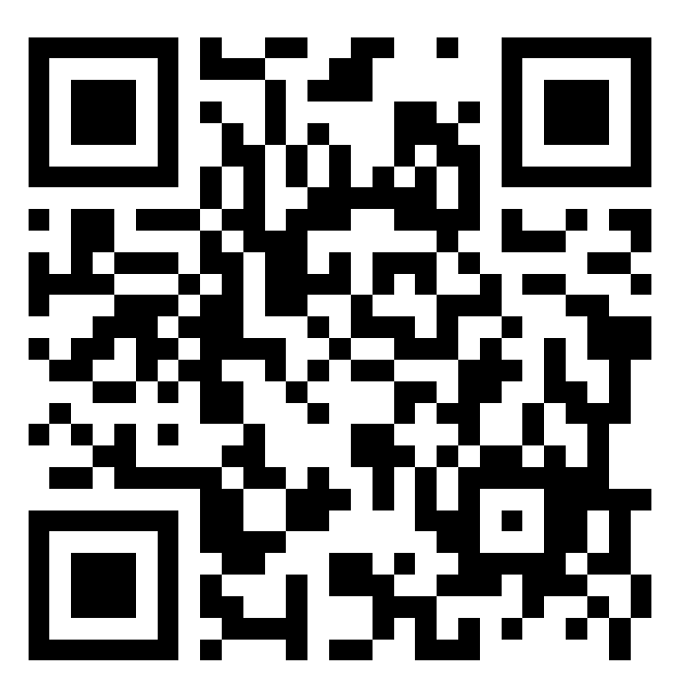

Session 1: Basics of R and RStudio
Attendance survey:
https://forms.gle/Dz1s23uGLFnndgEa7
15.003 Software Tools | MBAn Orientation 2024
Yu Ma, Vassilina Stoumpou
Notes:
Image from http://commons.wikimedia.org/wiki/File:Ciak.jpg

Slide 2
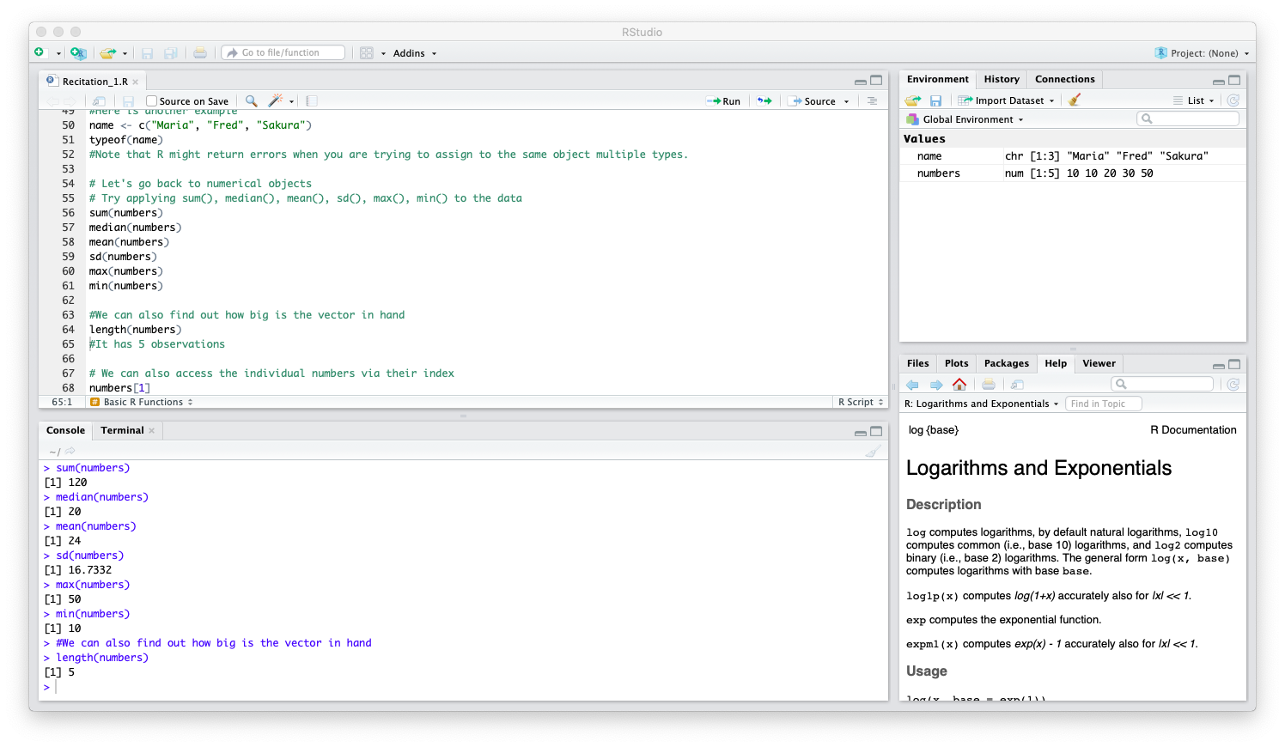
RSTUDIO INTERFACE
Data Viewer
Code Editor
Misc. Tools
Console

Slide 3
RSTUDIO INTERFACE
Code Editor: Window for viewing and editing scripts.
Console: Window for running code and viewing the output of your commands.
Data Viewer: Lists all stored variables. More complex data objects (such as data frames) can be double-clicked to view in a full window format.
Misc. Tools: Includes tabs for navigating through folders (Files), viewing figures (Plots), managing packages (Packages), and reading documentation (Help).

Slide 4
INSTALLING PACKAGES
Packages are add-ons in R for descriptive analytics, machine learning methods, etc.
Installing Packages:
The Packages tab is the easiest way to add packages (next slide).
You can also install packages by running install.packages(“pkg_name”) in the console.
Loading Packages:
Once a package is installed, you can activate it for your session by running library(“pkg_name”).

Slide 5
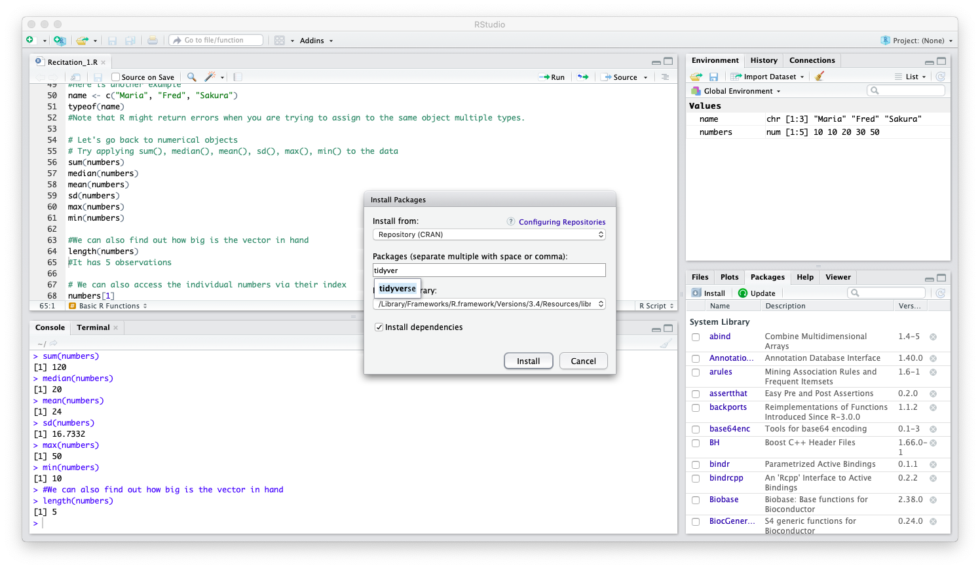
INSTALLING PACKAGES
Step 2
Step 1
** Once installed, you still must load the packages in each session using library(“package_name”)

Slide 6
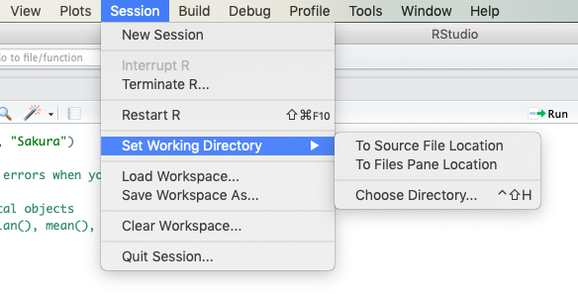
CHANGING THE WORKING DIRECTORY
The working directory tells R where to look when loading and saving files.

Slide 7
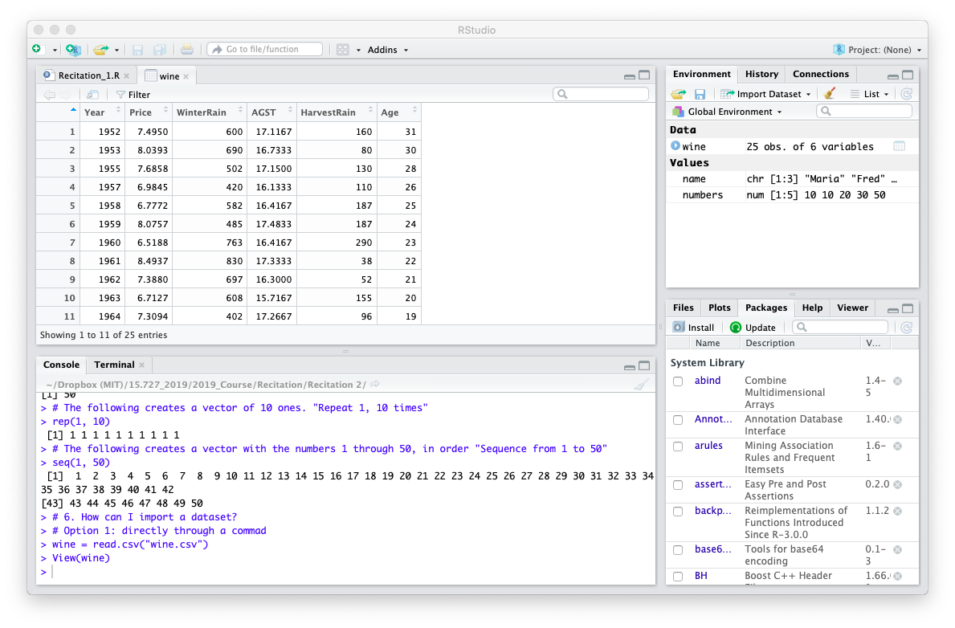
LOADING CSV DATA
Step 1: Navigate to the working directory that contains your dataset.
Step 2: Load the CSV file into R using wine = read.csv(“wine.csv”).
Once loaded, you can view the dataset by clicking on the data object name in the Environment tab or running View(wine)
Option 1
Option 2

Slide 8
TROUBLESHOOTING
Help functions: R has multiple ways to learn more about a given function or package.
EX. Run ?read.csv or help(read.csv) to get information about the read.csv function.
Debugging: Googling an error is often the best way to resolve it. R has a very active user base and many forums where people post questions–it is likely that many of your questions have already been asked by others too!
Warnings: Warning messages often show up when loading packages—as long as there are no errors, you do not have to worry about these.

Slide 9
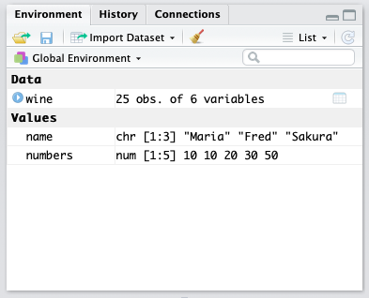
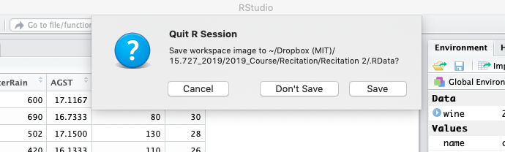
CLEARING THE WORKSPACE
At any point during the session, you can clear all variables by clicking the broom in the Data Viewer panel.
At the end of a session you have the option to save the workspace image to an .RData file.
Generally you do not need to do this. If you have saved all relevant outputs, there is no need to save the workspace image.
If you want to freeze the entire session in its current state to continue on later, you will want to save the .RData file. It will automatically restore your session when you next open RStudio.

Slide 10
R IN PRACTICE
Now, we’ll move over to R for hands-on practice working with data.

